Slide 1


Random Forest from scratch
Francesco Stucci

Slide 2
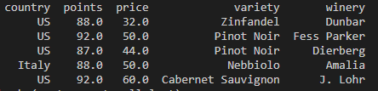
Dataset (https://www.kaggle.com/zynicide/wine-reviews)
Dataset head
Dataset shape: (104183, 5)

Slide 3

The goal
Our goal is to classify the Variety of wine based on the dataset features Country, Points, Price and Winery

Slide 4
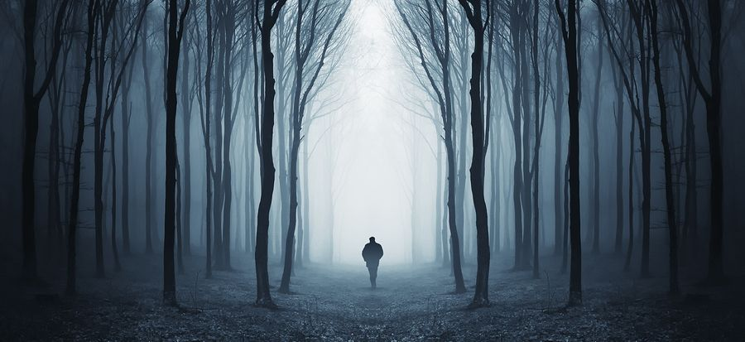
Which model are we supposed to use?
Our data consists of labled values and we need to classify categorical values.
We have more than 100 thousend samples and low-dimensionality (just 4 dimensions).
For these reasons I chose the Random Forest model to deal with it

Slide 5
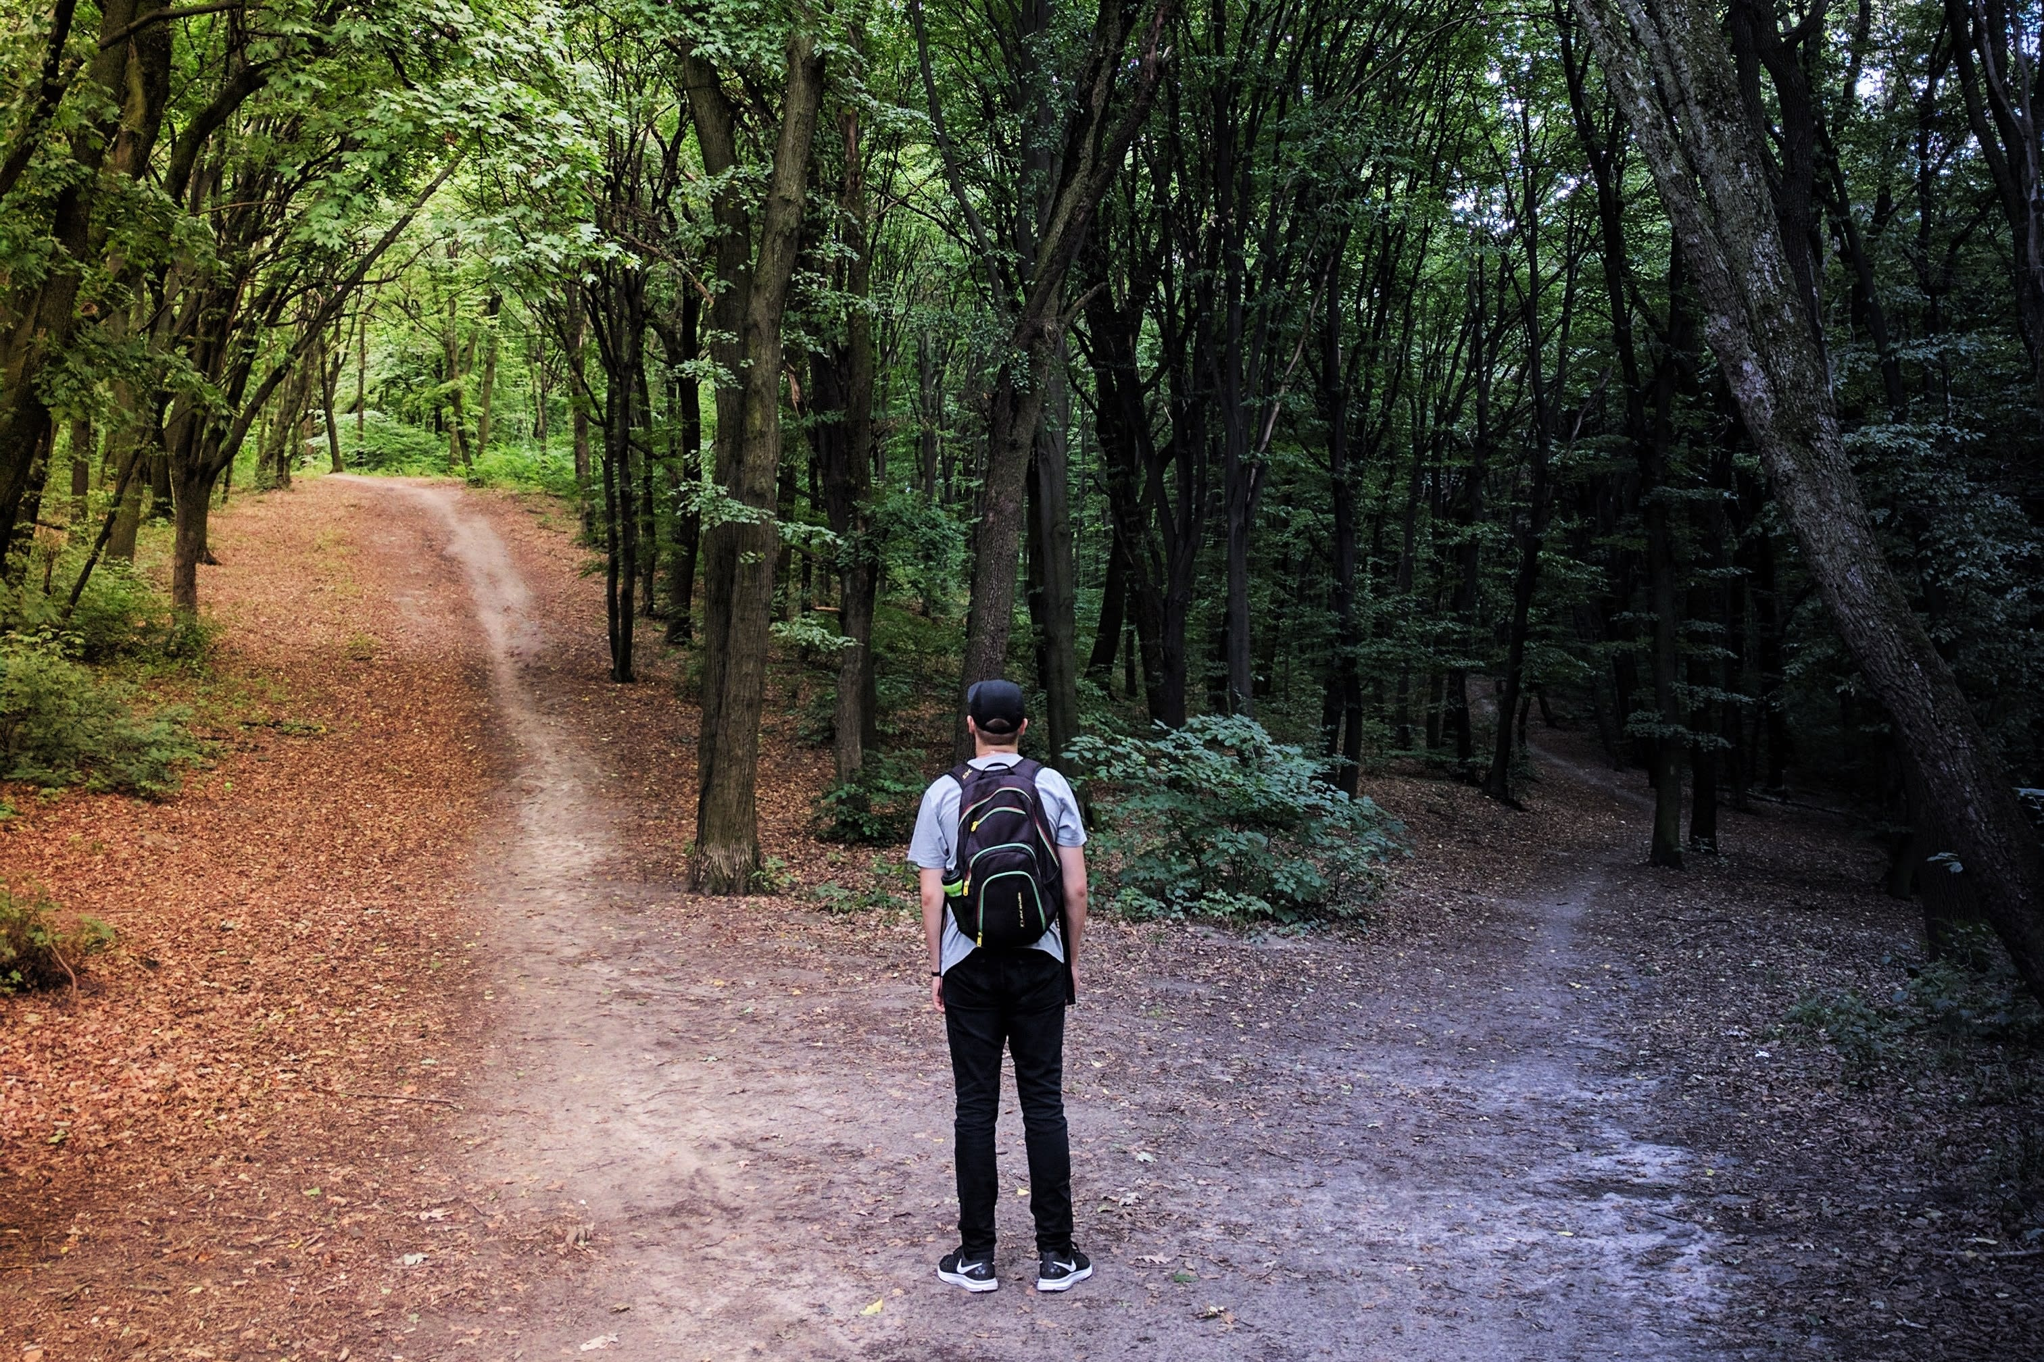
To build a Forest, we need Trees!
In order to build a Random Forest, we need first to define our Decision Tree

Slide 6
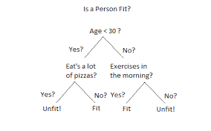
What a Decision Tree is
Decision Tree is a binary tree structure where each node corresponds to a question, whereas its children are the split dataset which correspond to the true or false response to the question

Slide 7
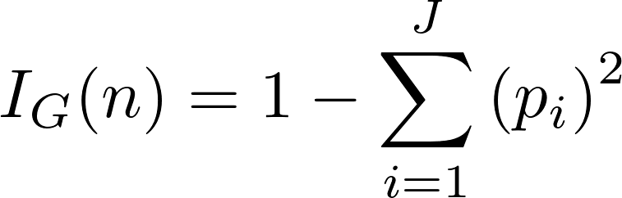
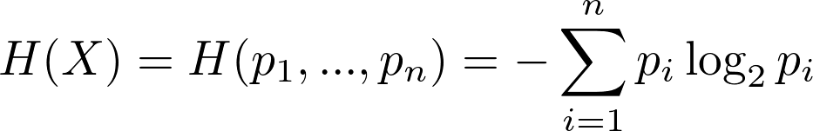
But the question is: which is the question?
We need to choose each node which question corresponds to. To select the question we have two
main method
Gini impurity:
Entropy:
By comparing these values between all question results, we choose the best one, which
means the one which give us more information

Slide 8
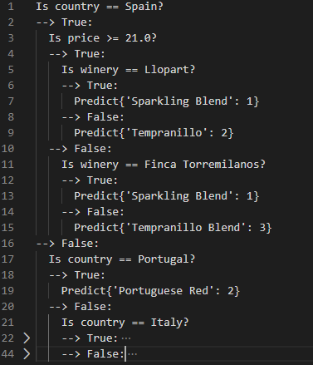
Our Decision Tree appearence

Slide 9
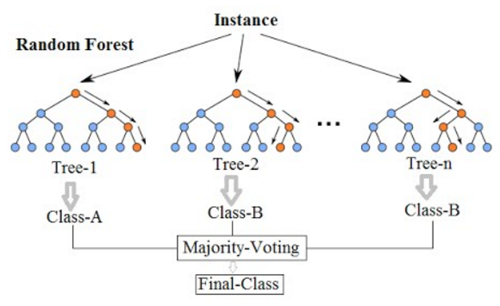
From Tree to Forest
Once we have our Decision Tree, to build a Random Forest we need to build more trees
and ensemble them.
To do so, we just give each tree a random subset of the whole dataset, with a random subset
of features (in order to decrese the similarity of our trees and avoid overfitting) and finally choose
the most voted category from our tree predictions

Slide 10
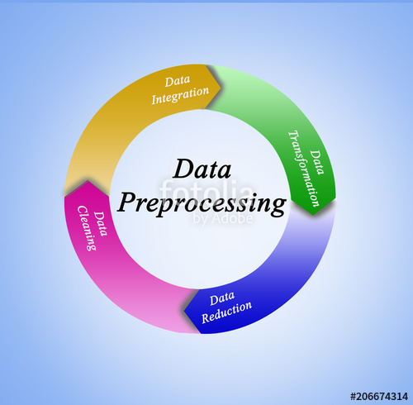
Data preprocessing
Machine learning models, usually, need some data analysis in order to find out missing data, outlayers and transform categorical values in numbers.
However Random Forest is able to deal with these problems natively.
In particular, on this dataset, the only preprocessing perfomed was to remove samples with missing price due to its fundamental impact.

Slide 11

Parameters
We have to tune few parameters in order to prevent overfitting and improve accuracy of our model
Number of trees
Number of features for each tree
Number of semples in each tree

Slide 12
Some results
With
#samples = #dataset_samples / log2(#trees)
#features = #dataset_ features
Decision Tree Accuracy: 0.1935
Random Forest (10 trees): 0.2215
Random Forest (30 trees): 0.265
Random Forest (60 trees): 0.273
Random Forest (100 trees): 0.28
With
#samples = #dataset_samples / log2(#trees)
#features = log2(#dataset_ features)
Decision Tree Accuracy: 0.1249
Random Forest (10 trees): 0.266
Random Forest (30 trees): 0.275
Random Forest (60 trees): 0.267
Random Forest (100 trees): 0.273

Slide 13
Some results
With
#samples = #dataset_samples / #trees
#features = #dataset_ features
Decision Tree Accuracy: 0.2665
Random Forest (10 trees): 0.278
Random Forest (30 trees): 0.2515
Random Forest (60 trees): 0.251
Random Forest (100 trees): 0.2285
With
#samples = #dataset_samples / #trees
#features = log2(#dataset_ features)
Decision Tree Accuracy: 0.257
Random Forest (10 trees): 0.124
Random Forest (30 trees): 0.186
Random Forest (60 trees): 0.1525
Random Forest (100 trees): 0.148

Slide 14

Comparing with SKLearn
The Random Forest implementation on this library is awfully faster as well as more accurate because of its optimizations…
(although my implementation can deal with categorical values )
Decision Tree Accuracy: 0.256
Random Forest (10 trees): 0.297
Random Forest (30 trees): 0.301
Random Forest (60 trees): 0.301
Random Forest (100 trees): 0.301

